Slide 1
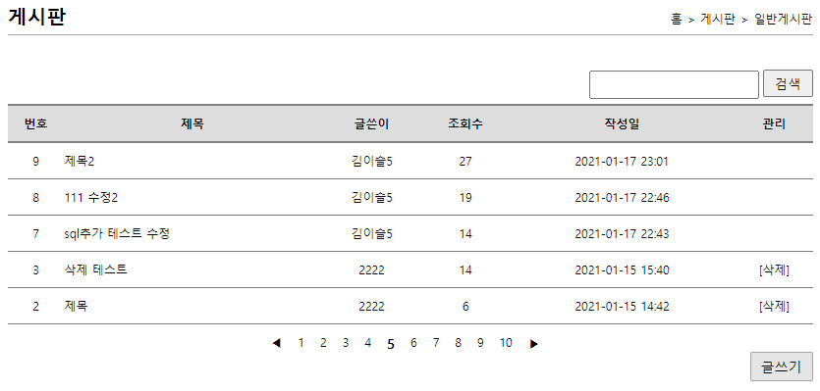
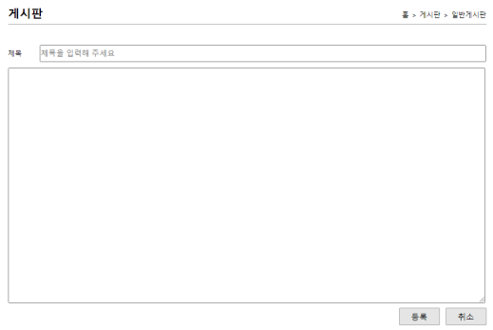
guestbook
00
사용자
jsp
controller
service
dao
sqlSession
xml
1. list(게시판 리스트)
alias=BoardVo
/board/list
List<BoardVo>
boardList()
List<BoardVo>
boardList()
selectList
(“board
.boardList”)
id="boardList"
resultType=“BoardVo"
/list
list(Model model)
list.jsp
boardList
boardList
boardList
포워드
BoardVo
model.addAttribute(“bList", boardList);
2.writeForm(글쓰기폼)
/board/writeForm
/writeForm
writeForm()
writeForm.jsp
포워드
/guest/add?name=표이슬&password=1234&content=테스트

Slide 2
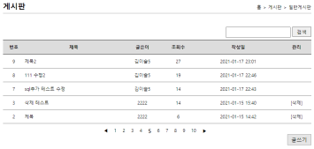
guestbook
00
사용자
jsp
controller
service
dao
sqlSession
xml
no=0,
title=333, name=null, content=333, hit=0,
date=null, user_no=8
alias=BoardVo
boardVo
3.write(글쓰기 등록)
no=0,
title=333, name=null, content=333, hit=0,
date=null, user_no=0
int no = ((UserVo)session.getAttribute("authUser")).getNo();
boardVo.setUser_no(no) // vo에user_no값 추가
/board/write?title=333&content=333
/write
write(@ModelAttribute
BoardVo boardVo,
HttpSession session)
boardVo
boardVo
boardVo
boardVo
/board/write
write(BoardVo
boardVo)
boardInsert
(boardVo voardVo)
insert(“board.boardInsert,
boardVo)
id=“boardInsert"
resultType=“BoardVo"
redirect:/board/list
리다이렉트
성공갯수
성공갯수
성공갯수
성공갯수
user_no,
title,
content
필요
4. remove(삭제)
/board/remove?no=8
no=8
no=8
/board/remove
no=8
no=8
no=8
/remove
remove(int no)
remove(int no)
/boardDelete
(guestBookVo)
delete ("board
.boardDelete",no)
id="boardDelete"
parameterType=“int”
redirect:/board/list
리다이렉트
성공갯수
성공갯수
성공갯수
성공갯수

Slide 3
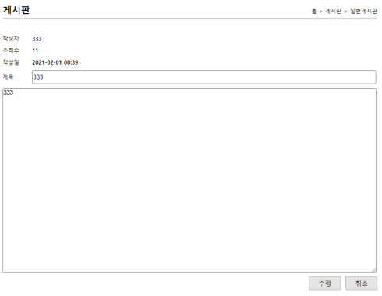
guestbook
00
사용자
jsp
controller
service
dao
sqlSession
xml
5.read(글읽기)
no
no
no
id="boardOne"
parameterType="int"
resultType="BoardVo"
boardOne(no)
selectOne(“board.boardOne“
, no)
/board/read?no=8
/read
read(@RequestParam("no") int no,
Model model)
no
boardVo
boardVo
boardVo
/board/read
read(int no)
no
read.jsp
포워드
no
no
boardHit(no)
update(“board.hitUpdate, no)
id="hitUpdate"
parameterType="int"
model.addAttribute("boardOne", boardService.read(no));
성공갯수
6. modifyForm(수정폼)
/board/modifyForm?no=8
no=8
no
no
/board/modifyForm
/modifyForm
modifyForm(@RequestParam("no")
int no, Model model)
no
no
selectOne(“board.boardOne“
, no)
id="boardOne"
parameterType="int"
resultType="BoardVo"
read(int no)
boardOne(no)
modifyForm.jsp
boardVo
포워드
boardVo
boardVo
boardVo
model.addAttribute("boardOne", boardService.read(no));
no=11, title=333, name=333, content=333, hit=8, date=2021-02-01 00:39, user_no=8

Slide 4
guestbook
00
사용자
jsp
controller
service
dao
sqlSession
xml
boardVo
7. modify(수정)
no=11, title=555, name=null, content=555, hit=0, date=null, user_no=0
/board/modify?no=8&title=555&content=555
/board/modify
boardVo
boardVo
boardVo
boardVo
/modify
modify(@ModelAttribute
BoardVo boardVo)
modify(BoardVo
boardVo)
boardUpdate
(BoardVo boardVo)
update("board.boardUpdate“
,boardVo)
id="boardUpdate"
parameterType
="BoardVo"
"redirect:/board/list"
리다이렉트
성공갯수
성공갯수
성공갯수
성공갯수

